Slide 1
Computer Vision
Object Detection and Recognition

Slide 2
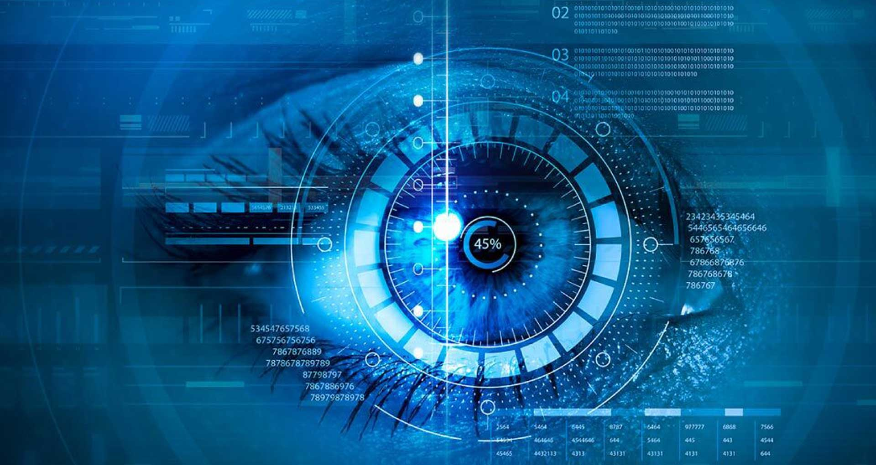
Introduction
Computer Vision helps machines see and understand pictures or videos.
A big part of this is finding objects and knowing what they are.
It is used in self-driving cars, security cameras, hospitals, and shops.

Slide 3
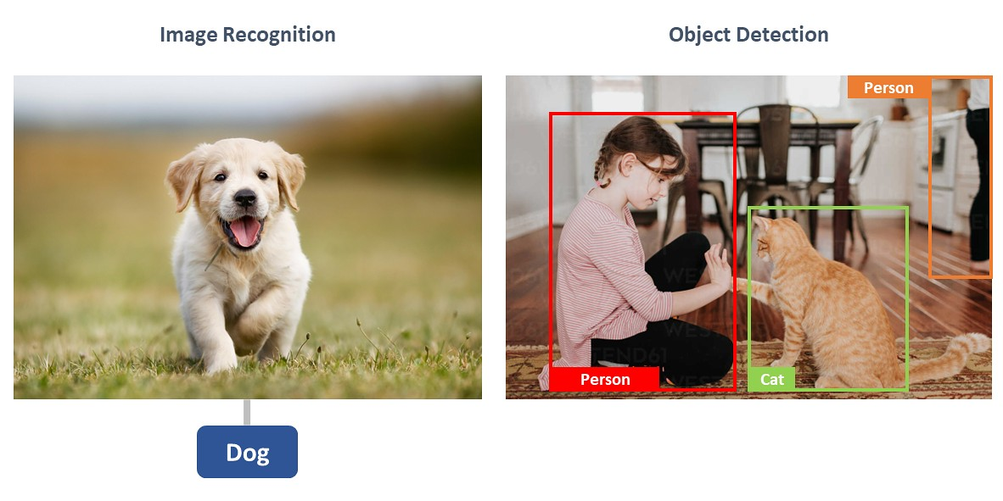
Object Recognition vs Detection
Image Recognition → Tells what the object is (e.g., “Dog”).
Object Detection → Finds where the objects are and labels them (e.g., “Person, Cat”).

Slide 4
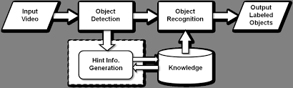
Workflow of Object Detection & Recognition
Input Video/Image → Give video/Image to the system.
Detect Objects → Find where objects are.
Recognize Objects → Identify what they are.
Use Knowledge → Get help from stored info.
Output → Show labeled objects.

Slide 5
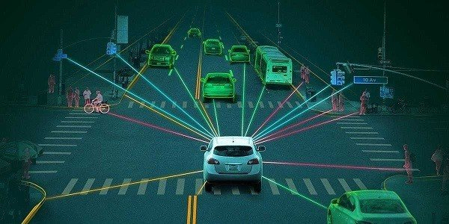
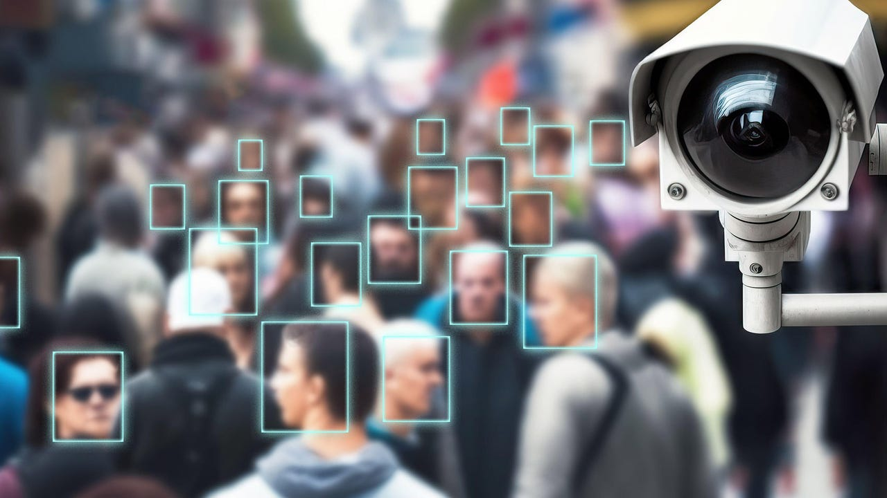
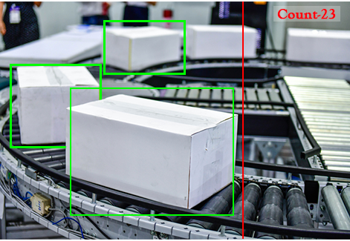
Applications
Self-Driving Cars → Find people, cars, and traffic signs
Security → Face recognition, camera monitoring
Shops/Retail → Identify products, count stock

Slide 6
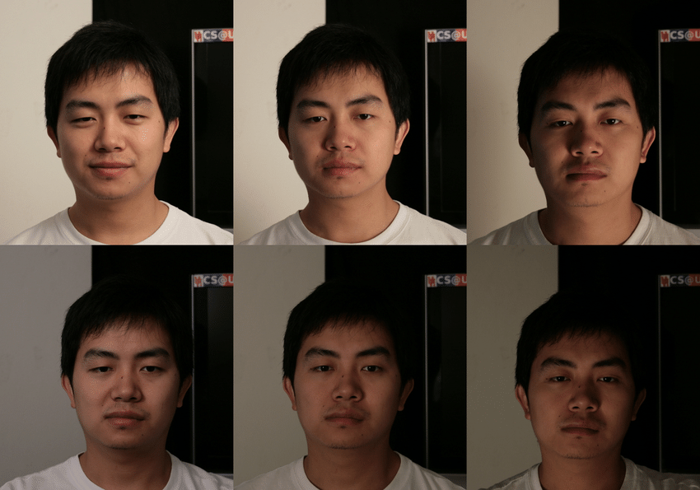
Challenges
Overlapping objects.
Variations in scale, lighting, and viewpoint.
Real-time processing requirements.
Large training data requirements.

Slide 7
Future Trends
Integration with Edge Computing for real-time analysis.
Self-learning systems with minimal supervision.
Explainable AI for transparency.
Improved accuracy with transformer-based models.

Slide 8
Thank You
The future sees what we’ve only just begun to imagine.

